Slide 1
DBMS FINAL PROJECT
By Alisha Atreja
Under the guidance of Professor Chaiyaporn Mutsaliklisana

Slide 2
Car RENTAL Management System

Slide 3
INTRODUCTION
The project is about fast-growing for online car rental booking management system with easy-to-maneuver features and functionalities that make it an ideal booking for customers.
The Project covers 9 tables smoothly explaining the Online Car Booking technology such as
Car Details Car Booking User
Car Type Rental Location User Credentials
Car Insurance Insurance Payment

Slide 4
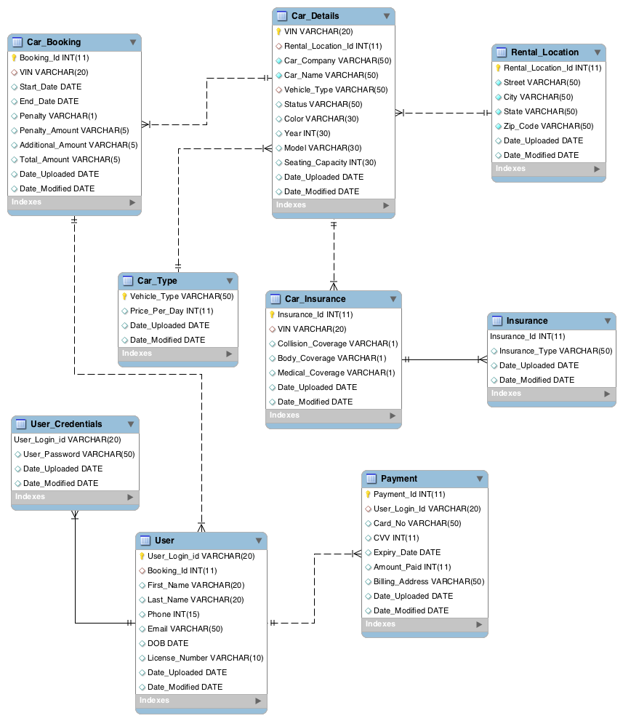
Entity Relationship Diagram

Slide 5
ERD EXPLANATION
Table CAR_DETAILS has the CAR info with VIN as Primary Key that connects it to other tables.
Table RENTAL_LOCATION stores information of the address and zip codes that are used for car booking
joined to CAR_DETAILS through Rental_Location_Id as this table’s primary key.
Table CAR_BOOKING records Trip Start and End Date with Booking_Id as the primary key , joined to table
CAR_DETAILS through VIN.
Table CAR_TYPE records the Price_Per_Day of Advance , Intermediate or Basic Cars , joined to table CAR_DETAILS through column VEHICLE_TYPE as it’s primary key
Table CAR_INSURANCE stores the insurance information with Insurance_Id as it’s primary key and joined
to table CAR_DETAILS through VIN.
Table INSURANCE stores the type of Insurance as Insurance_Type , joined to table CAR_INSURANCE
through Insurance_Id.
The USER table handles User’s information that have booked the car with User_Login_Id as the Primary key.
This table is joined to CAR_BOOKING through Booking_Id.
Table USER_CREDENTIALS stores User’s privacy information such as Username and Password , joined to User
Table through User_Login_Id
Table PAYMENT is used to record Card details along with the Amount to be paid with Payment_Id as the
primary key and joined to User table through User_Login_Id.

Slide 6
SET 1
Create DB, creates tables, create sample records/values/tuples, USE, and Drop DB

Slide 7
DDL Statements
Data Definition Language (DDL) statements are used to define the database structure or schema. Some examples:
1. CREATE - to create objects in the database
2. ALTER - alters the structure of the database
3. DROP - delete objects from the database
4. TRUNCATE - remove all records from a table, including all spaces allocated for the records are removed
5. COMMENT - add comments to the data dictionary
6. RENAME - rename an object

Slide 8
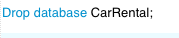
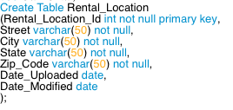
Create/USE database
DROP DATABASE
CREATE TABLE

Slide 9
DML Statements
Data Manipulation Language (DML) statements are used for managing data within schema objects. Some examples:
1. SELECT - retrieve data from the a database
2. INSERT - insert data into a table UPDATE - updates existing data within a table
3. DELETE - deletes all records from a table, the space for the records remain
4. MERGE - UPSERT operation (insert or update)
5. CALL - call a PL/SQL or Java subprogram
6. EXPLAIN PLAN - explain access path to data 7. LOCK TABLE - control concurrency

Slide 10
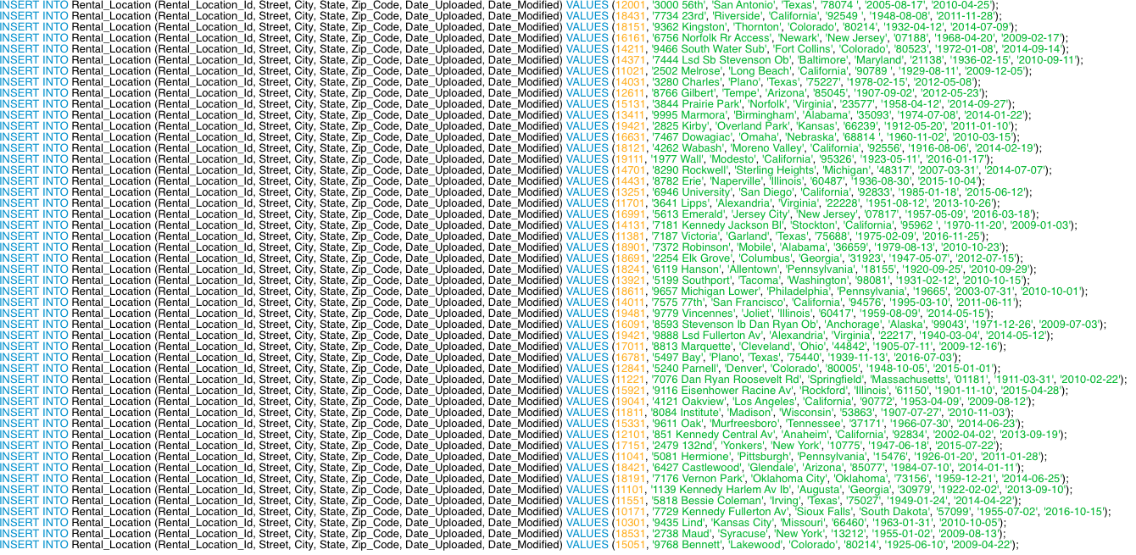
INSERT INTO TABLE 1

Slide 11
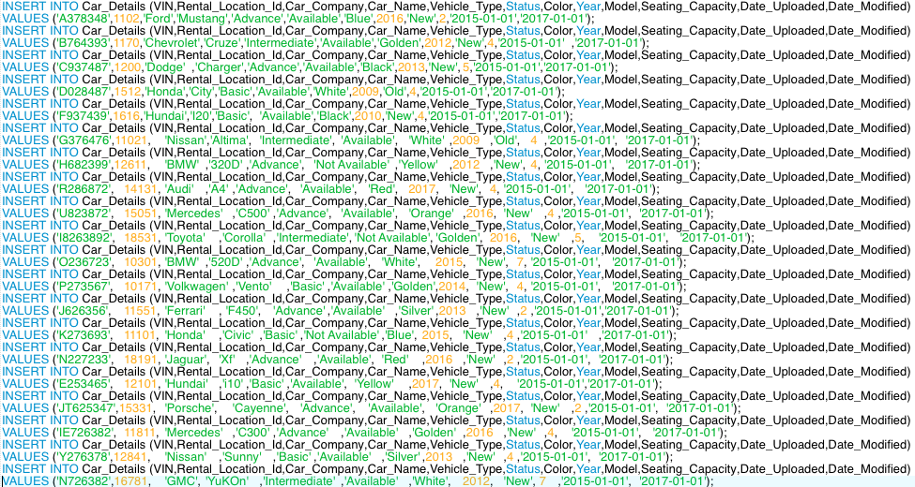
INSERT INTO TABLE 2

Slide 12
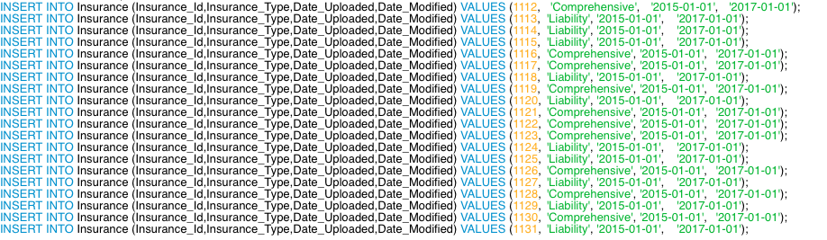
INSERT INTO TABLE 3
INSERT INTO TABLE 4

Slide 13
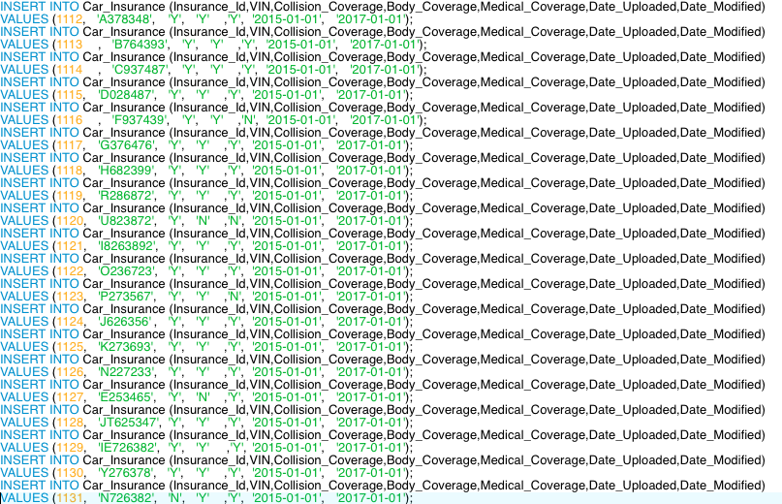
INSERT INTO TABLE 5

Slide 14
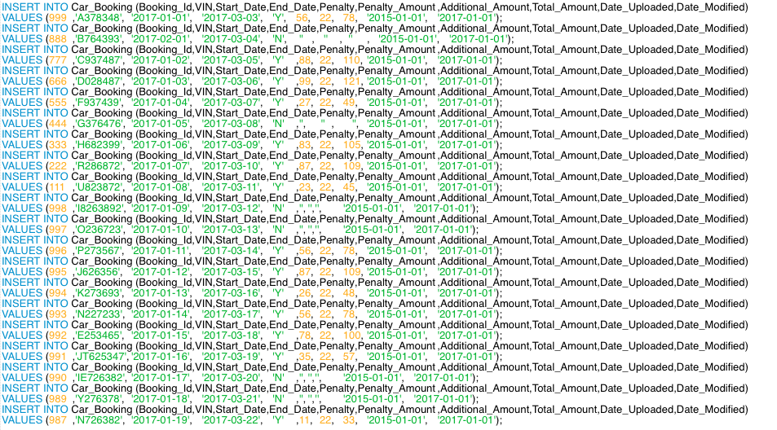
INSERT INTO TABLE 6

Slide 15
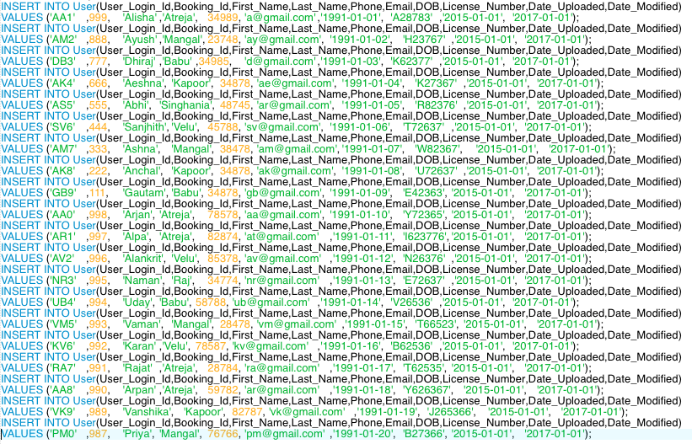
INSERT INTO TABLE 7

Slide 16
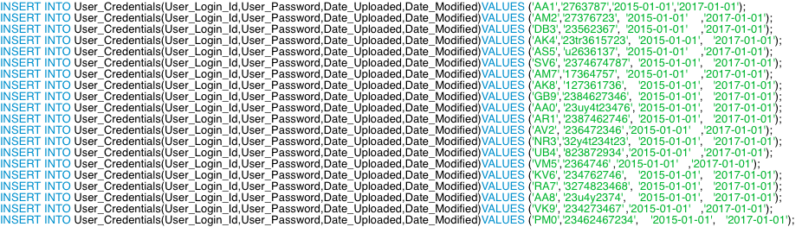
INSERT INTO TABLE 8

Slide 17
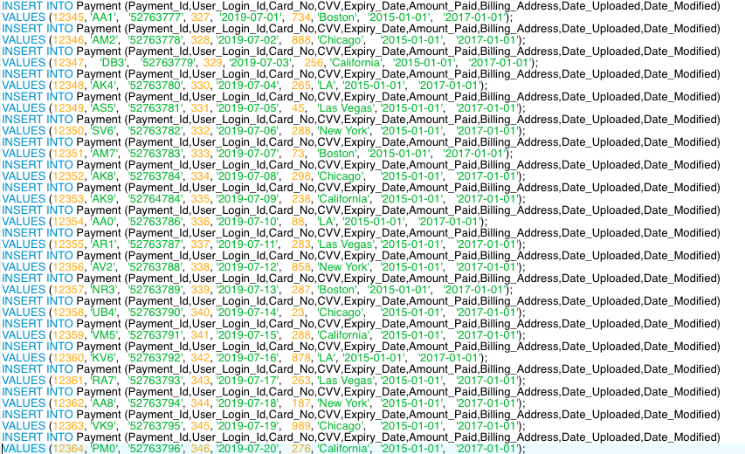
INSERT INTO TABLE 9

Slide 18
SET 2
Use DB, create tables with table options (NULL, Key, etc.), data types, insert, index and set

Slide 19
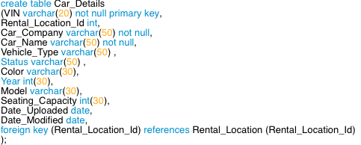
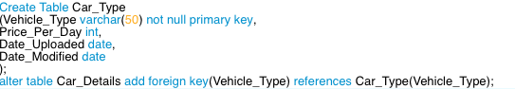
Tables Created In Car Rental Database
CREATE TABLE WITH FOREIGN KEY
ALTER COMMAND FOR ADDING
FOREIGN KEY

Slide 20
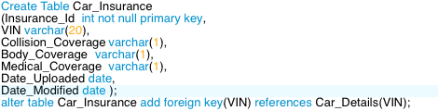
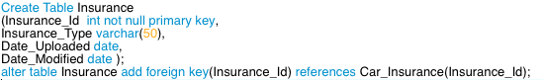
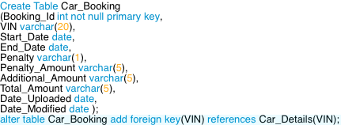
Tables Created In Car Rental Database
CREATE TABLE WITH PRIMARY , FOREIGN KEY ,
DATATYPES
CREATE TABLE WITH NULL VALUE
PRIMARY , FOREIGN KEY

Slide 21
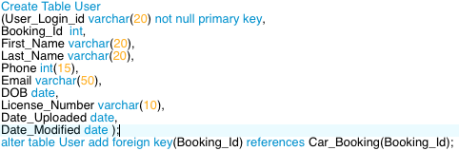
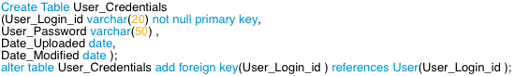
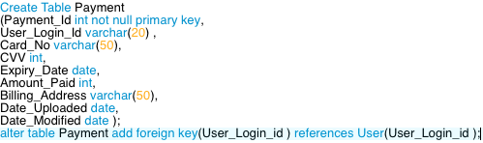
Tables Created In Car Rental Database
ALTER COMMAND FOR ADDING
FOREIGN KEY
CREATING INDEX FOR FASTER RESULTS

Slide 22
SET 3
Select – From – Where – Group By – Having - Order By – Limit

Slide 23
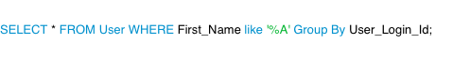
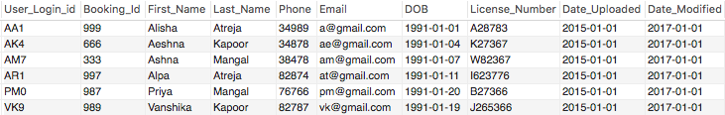

GROUP BY – Retrieves results ending with A grouped by User_Login_Id
HAVING – Retrieves results having restriction of User_Login_Id = ‘AA1’

Slide 24
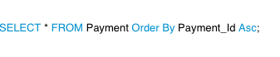
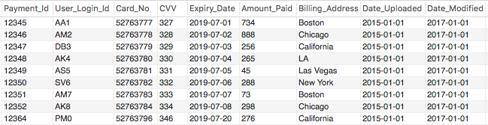
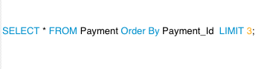
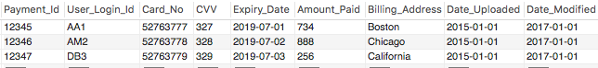
ORDEY BY – Retrieves results Sorted on the basis of Payment_Id
LIMIT - Retrieves results Sorted on the basis of Payment_Id with a limit to 3 records

Slide 25
SET 4
Select 10 functions in SQL statement of your choice (including but not limited to Comparison, control flow, cast, string, numeric, date/time manipulation, calculation, conversion, aggregate functions, etc.)

Slide 26
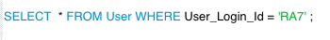
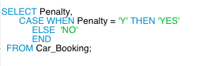
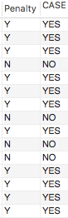
COMPARISON FUNCTION
The Query fetches results with equal comparison operator
CONTROL FLOW FUNCTION
The Query fetches result through a CASE statement with
Penalty as ‘YES’ or ‘NO’

Slide 27
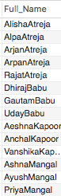
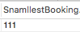
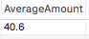
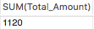
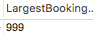
STRING FUNCTION
The Query Concatenates two strings FirstName and LastName
As FullName
CALCULATION FUNCTIONS

Slide 28
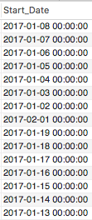

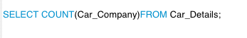
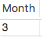
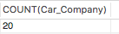
CAST FUNCTION
The function is used to convert Start_Date to datetime format
DATETIME FUNCTION
The Function is used to Count the rows on Car_Company
NUMERIC FUNCTION
The Month function fetches month number from End_Date

Slide 29
SET 5
Perform JOIN operation including INNER JOIN, LEFT JOIN, RIGHT JOIN, FULL JOIN, CROSS JOIN operations and display the sample result using SELECT statement

Slide 30
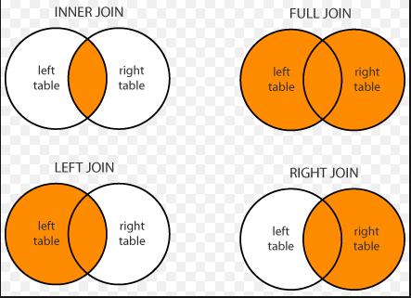
TYPES OF JOINS

Slide 31
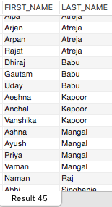
INNER JOIN
The INNER JOIN keyword selects records that have matching values in both tables.

Slide 32
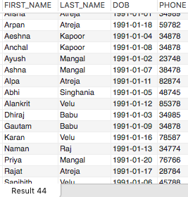
LEFT JOIN
The LEFT JOIN keyword returns all records from the left table (table1), and the matched records from the
right table (table2). The result is NULL from the right side, if there is no match.

Slide 33
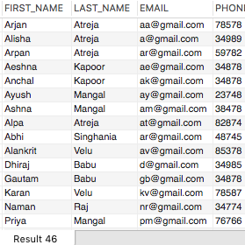
RIGHT JOIN
The RIGHT JOIN keyword returns all records from the right table (table2), and the matched records from the left table (table1). The result is NULL from the left side, when there is no match.

Slide 34
FULL OUTER JOIN
The FULL OUTER JOIN keyword return all records when there is a match in either left (table1) or right
(table2) table records.

Slide 35
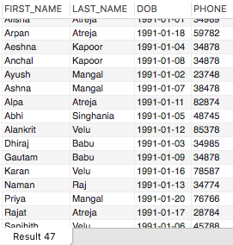
CROSS JOIN
The SQL CROSS JOIN produces a result set which is the number of rows in the first table multiplied by the
number of rows in the second table if no WHERE clause is used along with CROSS JOIN.

Slide 36
SET 6
Perform Queries and Sub-queries operations and display the result using SELECT statement

Slide 37
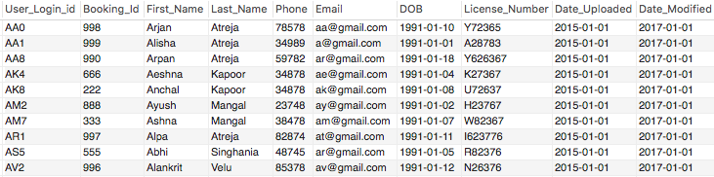
Simple Queries

Slide 38
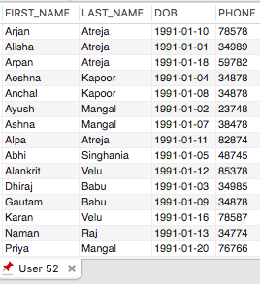
SubQueries – EXAMPLE 1
The Query withdraws results from User and User Credential Table joined through User_Login_Id

Slide 39
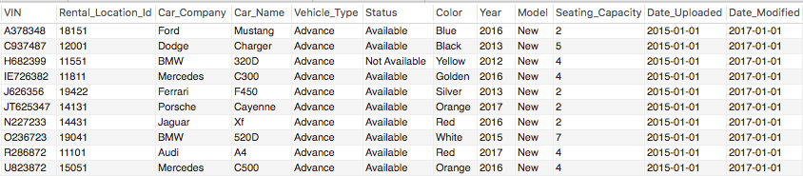
SubQueries – EXAMPLE 2
The Query withdraws results from Car_Details and Car_TypenTable joined through Vehicle_Type and Prce_Per_Day = 70

Slide 40
SET 7
Create four different users (Admin, Tester, Developer and User) with different privilege settings and display access differentiation among four users. Use GRANT and REVOKE command to give/remove additional access/rights to DB.

Slide 41
PRIVILEGES
When a PointBase database is first created the only user is the default user PUBLIC with a password of PUBLIC. The PUBLIC user owns the default PUBLIC schema. For security reasons, PointBase does not recommend using this schema to store sensitive data. Like any PointBase user, PUBLIC must be granted the appropriate privileges to access data objects in schema owned by other users.
The PUBLIC user can be used initially to create new users and new schema. The PUBLIC user will own any new schema that it creates unless otherwise specified during schema creation. New users are then able to create their own new schema and users, and grant appropriate privileges on schema that they own. All new users must be granted privileges to use the PUBLIC schema if this is required.
To grant the ability for a user to pass a privilege on to other users once granted, you must specify the optional WITH GRANT OPTION qualifier when granting the privilege.

Slide 42

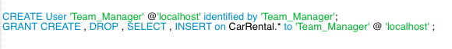
PRIVILEGES
The Admin has been granted all the privileges to perform all the operations
The Team Manager has only been given two DDL and two DML privileges

Slide 43
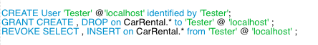
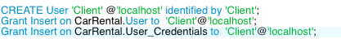
PRIVILEGES
The Tester has been given two DDL privileges but revoked two DML privilege
The Client has been given Insert privilege on User and User Credential table

Slide 44
Set 8
Create two examples of STORED PROCEDURE and display the results.

Slide 45
Stored Procedures
A stored procedure in SQL Server is a group of one or more Transact-SQL statements or a reference to a Microsoft .NET Framework common runtime language (CLR) method. Procedures resemble constructs in other programming languages because they can:
Accept input parameters and return multiple values in the form of output parameters to the calling program.
Contain programming statements that perform operations in the database. These include calling other procedures.
Return a status value to a calling program to indicate success or failure (and the reason for failure).

Slide 46
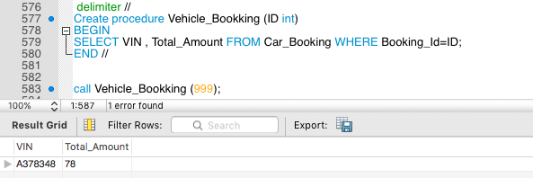
Stored Procedures – Example 1
This Procedure calls for Booking_Id that is used to automatically then invoke result through procedure

Slide 47
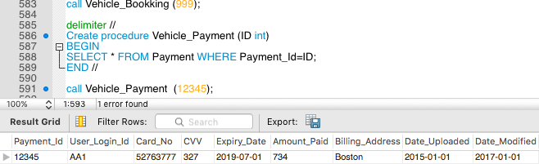
Stored Procedures – Example 2
This Procedure calls for Payment_Id that is used to automatically then invoke result through procedure

Slide 48
Set 9
Perform COMMIT and ROLLBACK operations with SAVEPOINT/ROLLBACK TO SAVEPOINT. Include the use of LOCK/UNLOCK Table operations. Display result of each operation.

Slide 49
Transactions
A transaction is a single unit of work. If a transaction is successful, all of the data modifications made during the transaction are committed and become a permanent part of the database. If a transaction encounters errors and must be canceled or rolled back, then all of the data modifications are erased.
SQL Server operates in the following transaction modes:
Autocommit transactions Each individual statement is a transaction.
Explicit transactions Each transaction is explicitly started with the BEGIN TRANSACTION statement and explicitly ended with a COMMIT or ROLLBACK statement.
Implicit transactions A new transaction is implicitly started when the prior transaction completes, but each transaction is explicitly completed with a COMMIT or ROLLBACK statement.

Slide 50

TRANSACTION
TRANSACTIONS

Slide 51

TRANSACTION OUTPUT
Using Rollback to AA2 , the transaction automatically derives results till User_Login_Id = ‘AA2’

Slide 52
SET 10
Perform Triggers operations using INSERT, UPDATE, DELETE and display result

Slide 53

TRIGGERS - INSERT
A trigger is a special kind of stored procedure that automatically executes when an event occurs in the
database server. DML triggers execute when a user tries to modify data through a data manipulation
language (DML) event. DML events are INSERT, UPDATE, or DELETE statements on a table or view.
These triggers fire when any valid event is fired, regardless of whether or not any table rows are affected.

Slide 54

TRIGGERS - UPDATE
TYPES
After Delete Trigger.
After Insert Trigger.
After Update Trigger.
Before Delete Trigger.
Before Insert Trigger.
Before Update Trigger.
Disable All Triggers.
Disable Trigger

Slide 55
TRIGGERS - DELETE
After Delete Trigger

Slide 56
Set 11
Perform three examples of VIEW operation (1) Simple, 2) and 3) with increasing Complexities) Create a backup plan of your choice, state your assumptions/constraints and explain your reasoning. Print your selection on a sample monthly calendar (say 30 day) with FB for Full Backup and IB for Incremental Backup

Slide 57
views
In SQL, a view is a virtual table based on the result-set of an SQL statement.
A view contains rows and columns, just like a real table. The fields in a view are fields from one or more real tables in the database.
You can add SQL functions, WHERE, and JOIN statements to a view and present the data as if the data were coming from one single table.

Slide 58

VIEW 1
This View Displays User Details with Booking-Id between range 888 and 999

Slide 59

VIEW 2
This View Displays Payment Details with CVV > 345

Slide 60

VIEW 3
This View Displays User Credential Details for User_Login_Id = ‘AA8’

Slide 61

Backup strategy
The temporary strategy is to Export the
results manually through the database
on periodic basis

Slide 62

Thankyou

